Slide 1


Genome assembly
MODULE 2 · DAY 2
From clean reads to a complete, accurate genome for every isolate
Neonatal AMR genomic surveillance of K. pneumoniae and E. coli
KlebGen training · Africa CDC and ILRI
Module 2 · Genome assembly | Day 2
Notes:
Welcome to Day 2. Yesterday we checked that the reads are good enough and that each culture is pure. Today we turn those reads into genomes: short-read assemblies with Shovill, long-read assemblies with Autocycler, and hybrid assemblies polished with both. By the end of the day every isolate has one best assembly, which is what we use from Day 3 onwards.

Slide 2

Day 2 at a glance
Session | Time | Topic
1 | 09:00–10:30 | How assemblers work; short-read assembly with Shovill
2 | 11:00–12:30 | Assembly quality: QUAST, CheckM2, Bandage
3 | 13:30–15:00 | Long-read assembly with Autocycler
4 | 15:30–17:00 | Polishing to a hybrid assembly; comparing all three
You will produce
an assembly QC table with a fit-for-purpose decision for every isolate
Module 2 · Genome assembly | Day 2
2
Notes:
Four sessions, all Module 2. Each session starts with a short talk, then hands-on work on the HPC. The deliverable at the end of the day is one assembly QC table with a decision for every isolate: is it good enough for typing, for SNP analysis, for plasmid work, or should it be excluded?

Slide 3
By the end of today you can
1
Explain why repeats break short-read assemblies into many contigs.
2
Assemble Illumina reads with Shovill, and Nanopore reads with Autocycler.
3
Polish a long-read assembly with Medaka, then with Illumina reads (Polypolish and Pypolca).
4
Judge an assembly with QUAST, CheckM2 and Bandage, and decide what it is good enough for.
Module 2: Genome assembly
Module 2 · Genome assembly | Day 2
3
Notes:
The four learning objectives map onto the four sessions. Objective 1 is the key idea of the morning: repeats longer than the reads are what break short-read assemblies, and that is why we bother with long reads in the afternoon.

Slide 4

How assemblers work
SESSION 1 · 09:00–10:30
Overlap graphs, de Bruijn graphs, repeats, and short-read assembly with Shovill
Module 2 · Genome assembly | Day 2
4
Notes:
Session 1. First the ideas: what an assembler does and the two main families of algorithms. Then why repeats are the central problem. Then we run Shovill on one isolate.

Slide 5
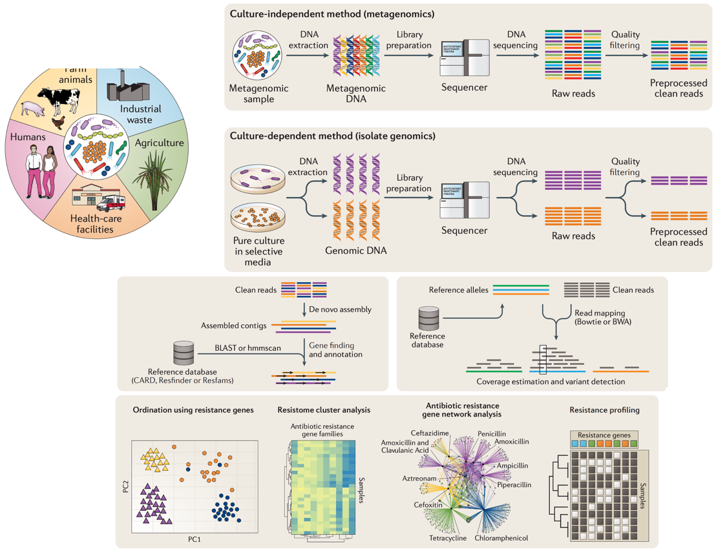
Where assembly fits
Isolate genomics: one pure culture, one genome
Day 1: raw reads → clean reads
Today: clean reads → assembled contigs (de novo, no reference)
Days 3–5: genes, types and plasmids are found in the contigs
Day 6: reads are also mapped to a reference to call SNPs
Boolchandani M, et al. Nat Rev Genet 2019. doi:10.1038/s41576-019-0108-4
Module 2 · Genome assembly | Day 2
5
Notes:
This figure shows the two routes from sequencing to AMR profiles. We work with isolates (the culture-dependent route). Clean reads can either be assembled de novo into contigs, then searched for genes, or mapped to reference alleles. Today is the assembly branch; the mapping branch comes back on Day 6 for SNPs.

Slide 6
Three kinds of assembly
 | Short-read | Long-read | Hybrid (long-read first, short-read polished)
Reads | Illumina, 150 bp | Nanopore, 1–100+ kb | Both
Typical result for K. pneumoniae | 30–100 contigs | Chromosome + plasmids, often circular | Chromosome + plasmids, circular, base-accurate
Good for | MLST, gene detection, SNPs | Structure: which genes sit on which plasmid | Everything, including plasmid tracking
Weakness | Plasmids broken at repeats (IS elements) | Small plasmids can be missed; base errors before polishing | Needs both data types
Today's tools | Shovill (SPAdes) | Autocycler (Flye, Raven) | Medaka, Polypolish, Pypolca
Module 2 · Genome assembly | Day 2
6
Notes:
The whole day in one table. Short reads are accurate but short, so they assemble into many contigs. Long reads span repeats, so they give whole replicons, but they carry more base errors until they are polished. A hybrid takes the structure from the long reads and the base accuracy from the short reads. In the training set, three isolates have both read types: CHI11E, CNS1F1 and 1013757.

Slide 7
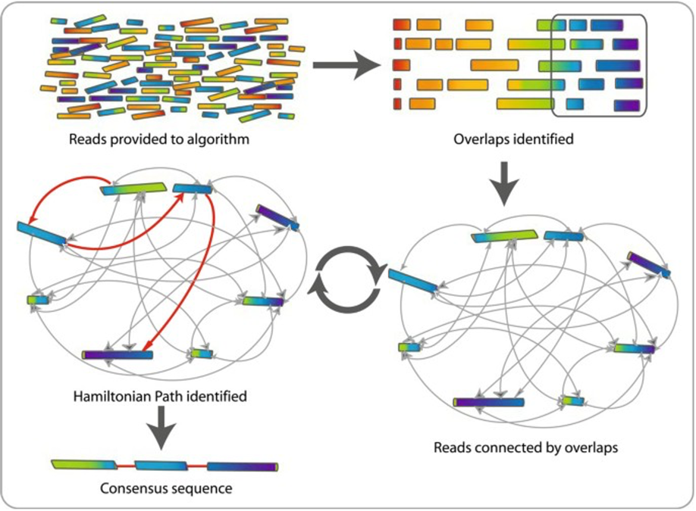
Assembly algorithms: overlap–layout–consensus
Reads are provided to the algorithm.
Overlapping regions are identified.
Each read is a node in a graph; each overlap is an edge joining two reads.
The algorithm finds the best path through the graph (a Hamiltonian path); unused nodes and edges are discarded.
This is repeated, and the results are combined into a consensus sequence that represents the genome.
Commins J, et al. Biol Proced Online 2009. doi:10.1007/s12575-009-9004-1
Module 2 · Genome assembly | Day 2
7
Notes:
Overlap-layout-consensus is the intuitive approach: find which reads overlap, lay them out in order, and take a consensus. Comparing every read with every other read is expensive, so OLC suits a smaller number of long reads. Long-read assemblers such as Raven, which Autocycler uses this afternoon, build this kind of overlap (string) graph.

Slide 8
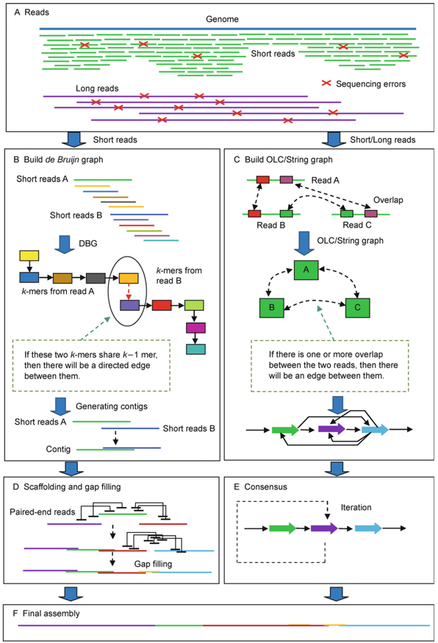
Assembly algorithms: de Bruijn graph
Chop the reads into much shorter k-mers.
Use all the k-mers to form a de Bruijn graph: two k-mers that share k–1 bases are joined by an edge.
Infer the genome sequence from paths through the graph.
Short reads → de Bruijn graph
Long reads → overlap graphs
Millions of short, accurate reads. SPAdes (inside Shovill) works this way.
Fewer, longer reads with more errors. Flye and Raven (inside Autocycler).
Liao X, et al. Quantitative Biology 2019. doi:10.1007/s40484-019-0166-9
Module 2 · Genome assembly | Day 2
8
Notes:
The de Bruijn graph avoids comparing every read with every other read: each read is cut into k-mers and the k-mers become the graph. This scales to millions of short reads, which is why short-read assemblers such as SPAdes use it. Shovill runs SPAdes with several k-mer sizes. The figure contrasts both approaches: de Bruijn graphs for short reads on the left, OLC or string graphs for long reads on the right.

Slide 9
Why repeats break short-read assemblies
Genome
IS26
IS26
Short reads
Long read
Short read inside a repeat
Long read across a repeat
It fits both IS26 copies equally well, so the assembler cannot tell which unique sequence follows. The contig stops at the repeat.
It covers the whole repeat with unique sequence on both sides, so the path through the genome is clear.
Module 2 · Genome assembly | Day 2
9
Notes:
This is the most important idea of the morning. Insertion sequences such as IS26 are present in several copies. A 150 bp read from inside an IS26 copy matches every copy, so the graph has a knot there and the assembler stops the contig. Resistance genes are often flanked by IS26, which is why, in a short-read assembly, a resistance gene often sits at the very end of a contig, and why short reads alone rarely tell you which plasmid carries the gene. A long read that spans the repeat resolves it. Diagram not to scale.

Slide 10
Shovill: assembly of bacterial isolates
# | What Shovill does | Tool
1 | Estimate genome size and read length (unless --gsize is given) | mash
2 | Subsample the reads to a sensible depth (default --depth 100) | seqtk
3 | Trim adapters from the reads (with --trim only) | trimmomatic
4 | Conservatively correct sequencing errors in the reads | lighter
5 | Pre-overlap ("stitch") paired-end reads | flash
6 | Assemble, with a modified k-mer range, paired + stitched reads | SPAdes (or SKESA, Megahit)
7 | Correct minor errors by mapping the reads back to the contigs | bwa mem + pilon
8 | Remove contigs that are too short, low coverage, or homopolymers
9 | Write the final FASTA with tidy names and annotations
On the course: reads already trimmed by fastp (no --trim); --minlen 200 drops short contigs.
Module 2 · Genome assembly | Day 2
10
Notes:
Shovill is a wrapper: one command runs a sensible chain of tools around the SPAdes assembler. Most of its steps are about preparing the reads (subsampling to about 100x depth makes SPAdes faster without losing quality) and cleaning up the result. The output folder has contigs.fa, the assembly, and contigs.gfa, the assembly graph we look at in Bandage later.

Slide 11
Hands-on: assemble CHI11E with Shovill
use_tools assembly
mkdir -p $RESULTS/02_assembly/shovill
# One sample first: with 1 thread allow about an hour, so start it before a break
s=CHI11E
shovill --R1 $COURSE/trimmed/${s}_R1.fastq.gz --R2 $COURSE/trimmed/${s}_R2.fastq.gz \
--outdir $RESULTS/02_assembly/shovill/$s --cpus $THREADS --minlen 200
# How many contigs?
grep -c ">" $RESULTS/02_assembly/shovill/$s/contigs.fa
Tip
Pre-computed Shovill assemblies for all 29 isolates are in $SHARED/precomputed/02_assembly/shovill/.
Assemble two or three yourself, then copy the rest:
cp -rn $SHARED/precomputed/02_assembly/shovill/* $RESULTS/02_assembly/shovill/
Module 2 · Genome assembly | Day 2
11
Notes:
Everyone starts CHI11E now. With one thread it takes roughly an hour, so start it before the break. CHI11E also has Nanopore reads, so this afternoon you can compare this short-read assembly with its long-read and hybrid assemblies. While it runs, copy the pre-computed assemblies for the other isolates so you can move on to quality checks in Session 2.

Slide 12

Assembly quality
SESSION 2 · 11:00–12:30
QUAST, CheckM2 and Bandage: is this assembly good enough, and for what?
Module 2 · Genome assembly | Day 2
12
Notes:
Session 2. An assembly always comes out, even from bad data. This session is about judging it: the numbers QUAST reports, the completeness and contamination CheckM2 estimates, the published QC standards for Klebsiella, and what the assembly graph looks like in Bandage.

Slide 13
What to look at in an assembly
Contigs
Total length
N50
GC content
Fewer is better. Short-read K. pneumoniae: typically 30–100.
K. pneumoniae 5.2–5.8 Mb; E. coli 4.6–5.5 Mb.
Half of the assembly is in contigs at least this long. Higher is better.
K. pneumoniae about 57%; E. coli about 51%.
QUAST
QUAST reports the four numbers above for each assembly. CheckM2 estimates completeness (how much of the expected gene content is there) and contamination (genes from more than one genome).
CHECKM2
Module 2 · Genome assembly | Day 2
13
Notes:
Four numbers from QUAST and two from CheckM2 tell you most of what you need. The number of contigs and N50 measure fragmentation. Total length and GC tell you whether the assembly is the right organism and only that organism: a genome twice the expected size, or a GC content between the Klebsiella and E. coli values, suggests a mixed culture. CheckM2 estimates completeness and contamination from marker genes.

Slide 14
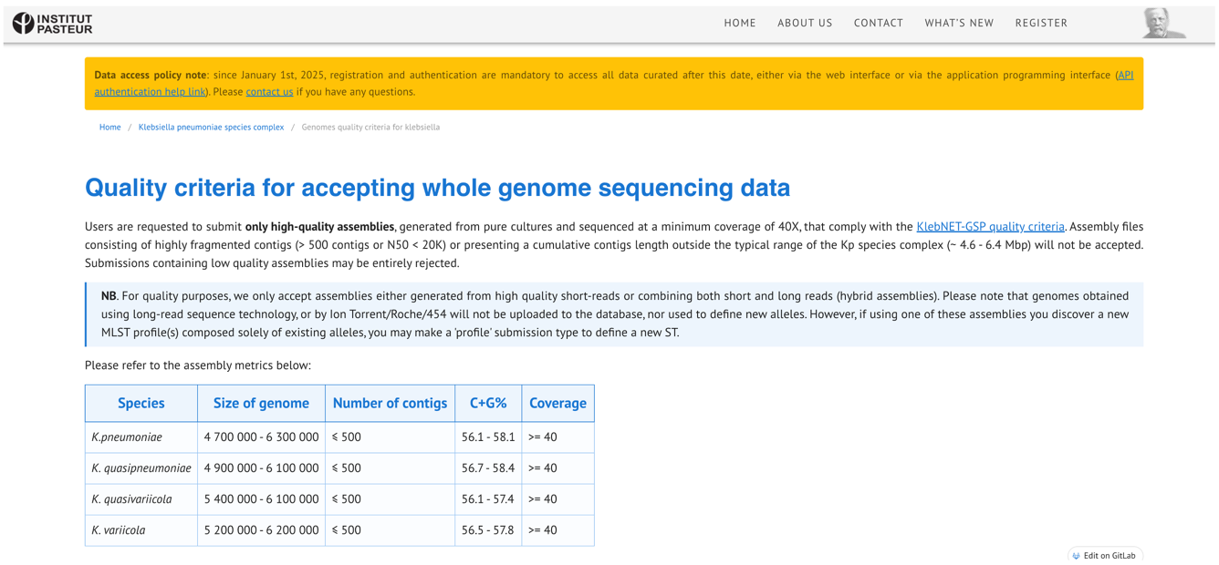
QC standards for K. pneumoniae genome assemblies
To be accepted, an assembly needs
≤ 500 contigs
and N50 of 20 kb or more
4.7–6.3 Mb
K. pneumoniae genome size
≥ 40× coverage
Institut Pasteur, Klebsiella BIGSdb · github.com/klebgenomics/Klebsiella-genome-metadata
from a pure culture
Module 2 · Genome assembly | Day 2
14
Notes:
These are the criteria the Institut Pasteur Klebsiella database uses before it accepts a genome: high-quality assemblies from pure cultures, at least 40x coverage, no more than 500 contigs, N50 of at least 20 kb, and a total length in the typical range for the species complex (about 4.6 to 6.4 Mb overall; 4.7 to 6.3 Mb for K. pneumoniae itself), with GC 56.1 to 58.1% for K. pneumoniae. Only short-read or hybrid assemblies are accepted. We use the same thresholds for our own fit-for-purpose decisions at the end of the day.

Slide 15



Red flags in a short-read assembly
Hundreds of contigs
Total size far outside the expected range
CheckM2 contamination above 5%
Any one of these makes SNP calling and gene detection unreliable. Two isolates in the training set:
9.46 Mb
1,468
D38119: about twice a K. pneumoniae genome, likely a mixed culture
CES13U: contigs. Neither isolate is fit for SNP-based transmission analysis.
Module 2 · Genome assembly | Day 2
15
Notes:
Values for D38119 and CES13U are from the study's tables. Ask the group: do your Day 1 Kraken2 and sequencing depth results explain them? A 9.5 Mb assembly is what you expect when two strains or species grow in the same culture. Over a thousand contigs usually means low depth or poor library quality.

Slide 16
Hands-on: QUAST and CheckM2
# Collect the Shovill assemblies in one folder
mkdir -p $COURSE/assemblies
for d in $RESULTS/02_assembly/shovill/*/; do
s=$(basename $d); cp $d/contigs.fa $COURSE/assemblies/${s}.fasta
done
# QUAST: one row per assembly; look at contigs, total length, N50 and GC
quast.py $COURSE/assemblies/*.fasta -o $RESULTS/02_assembly/quast_shovill -t $THREADS
less -S $RESULTS/02_assembly/quast_shovill/transposed_report.tsv
# CheckM2: completeness and contamination
checkm2 predict --input $COURSE/assemblies -x fasta \
--output-directory $RESULTS/02_assembly/checkm2 --threads $THREADS \
--database_path $SHARED/databases/checkm2/CheckM2_database/uniref100.KO.1.dmnd
cut -f1-3 $RESULTS/02_assembly/checkm2/quality_report.tsv | sort -t$'\t' -k3,3gr | head
Module 2 · Genome assembly | Day 2
16
Notes:
Run QUAST on all the Shovill assemblies at once: transposed_report.tsv has one row per assembly. Then CheckM2: the last command sorts by contamination, highest first, so problem isolates are at the top. Mark every isolate against the red flags and the Pasteur thresholds.

Slide 17
Looking at the assembly graph: Bandage
Short-read graph
Long-read or hybrid graph
A tangle: many contigs joined where repeats could not be resolved.
Ideally one closed loop per replicon: the chromosome and each plasmid.
The server has no screen, so Bandage draws each graph as an image. Copy the PNG files to your computer, or open the .gfa files in Bandage on your own computer.
s=CHI11E
Bandage image $RESULTS/02_assembly/shovill/$s/contigs.gfa $RESULTS/02_assembly/${s}_shovill.png
Bandage image $RESULTS/02_assembly/autocycler/$s/autocycler_out/consensus_assembly.gfa \
$RESULTS/02_assembly/${s}_autocycler.png
Module 2 · Genome assembly | Day 2
17
Notes:
Bandage shows the assembly graph rather than just the list of contigs, so you can see where the assembly breaks and why. Draw the Shovill graph now; draw the Autocycler graph after Session 3 and compare them. Tip: add your own CHI11E Bandage images to this slide once you have them.

Slide 18

Long-read assembly
SESSION 3 · 13:30–15:00
Spanning the repeats: whole chromosomes and plasmids with Autocycler
Module 2 · Genome assembly | Day 2
18
Notes:
Session 3. Three of our isolates also have Oxford Nanopore reads. Long reads span the repeats that broke the short-read assemblies, so we can get whole chromosomes and plasmids.

Slide 19
Long reads span the repeats
A read longer than the longest repeat crosses it, so each chromosome and plasmid can come out as one contig, often circular.
1–100+ kb
Small plasmids can be missed
Base errors before polishing
They are under-represented in long-read libraries.
Fixed in Session 4 with Medaka and the Illumina reads.
Nanopore read lengths, against 150 bp for Illumina
Module 2 · Genome assembly | Day 2
19
Notes:
Go back to the repeat diagram from Session 1: a long read covers the IS26 copy plus unique sequence on both sides. That is why long-read assemblies of K. pneumoniae often give one circular chromosome of about 5.3 Mb plus one contig per plasmid. Two weaknesses to remember: small plasmids are under-represented in long-read libraries, so they can be missing; and raw Nanopore assemblies still contain base errors until they are polished.

Slide 20


Autocycler: a consensus of many assemblies
Several assemblies from subsets of the reads, with different assemblers, then a consensus. This removes errors that only one assembler makes.
1 · helper genome_size
2 · subsample
3 · helper flye, raven
4 · compress
Estimate the genome size
Split the reads into 4 subsets
4 × Flye + 4 × Raven = 8 assemblies
Merge all 8 into one graph
5 · cluster
6 · trim
7 · resolve
8 · combine
Group contigs by replicon
Remove overlapping ends
One consensus per cluster
The final consensus assembly
Module 2 · Genome assembly | Day 2
20
Notes:
Autocycler is by Ryan Wick and colleagues (Bioinformatics 2025). Each yellow label is the autocycler subcommand that does that step. Any single long-read assembler makes occasional structural mistakes, such as a missing small plasmid or a duplicated end. Because Autocycler builds eight assemblies from different read subsets with two different assemblers and keeps what they agree on, one assembler's mistakes are outvoted.

Slide 21

Hands-on: Autocycler for CHI11E
use_tools assembly; s=CHI11E; reads=$COURSE/trimmed/${s}_ont.fastq.gz
mkdir -p $RESULTS/02_assembly/autocycler/$s && cd $RESULTS/02_assembly/autocycler/$s
genome_size=$(autocycler helper genome_size --reads $reads --threads $THREADS)
autocycler subsample --reads $reads --out_dir subsampled_reads --genome_size $genome_size
mkdir -p assemblies
for assembler in flye raven; do for i in 01 02 03 04; do
autocycler helper $assembler --reads subsampled_reads/sample_$i.fastq \
--out_prefix assemblies/${assembler}_$i --threads $THREADS --genome_size $genome_size
done; done
autocycler compress -i assemblies -a autocycler_out
autocycler cluster -a autocycler_out
for c in autocycler_out/clustering/qc_pass/cluster_*; do
autocycler trim -c $c; autocycler resolve -c $c
done
autocycler combine -a autocycler_out -i autocycler_out/clustering/qc_pass/cluster_*/5_final.gfa
grep ">" autocycler_out/consensus_assembly.fasta
With 1 thread this takes hours: start it, then continue from $SHARED/precomputed/02_assembly/autocycler/
Module 2 · Genome assembly | Day 2
21
Notes:
Autocycler runs Flye and Raven from inside its own image, so use_tools assembly is all that is needed. Eight assemblies with one thread take several hours, longer than the session. Start it, read about polishing while it runs, and continue from the pre-computed results. Compare them with yours when yours finishes. The final grep lists the contigs: look for one around 5.3 Mb (the chromosome) and smaller plasmid contigs, and check whether the headers mark them as circular.

Slide 22
Polishing to a hybrid assembly
SESSION 4 · 15:30–17:00
Medaka, Polypolish and Pypolca; then short-read, long-read and hybrid side by side
Module 2 · Genome assembly | Day 2
22
Notes:
Session 4. The long-read assembly has the right structure but still has base errors. We polish it, first with the long reads and then with the accurate Illumina reads, to get a hybrid assembly. Then we compare all three assemblies of CHI11E, and make an assembly decision for every isolate.

Slide 23


Polishing: long reads first, then short reads
DRAFT
LONG READS
SHORT READS
SHORT READS
RESULT
Autocycler consensus
Medaka
Polypolish
Pypolca
Hybrid assembly
A neural network corrects the consensus using the Nanopore reads
Uses every alignment of each read (bwa mem -a), so repeats get polished too
Fixes the remaining small errors (--careful)
Complete and base-accurate
Right structure, but Nanopore base errors
Medaka 2 can use a bacteria-specific model if your basecalling model supports it: check medaka_consensus -h for --bacteria.
Module 2 · Genome assembly | Day 2
23
Notes:
The order matters: long-read polishing first, because only long reads can fix errors in regions where short reads map ambiguously; then short-read polishing for base accuracy. Polypolish needs each read file aligned separately with all alignments kept (bwa mem -a), which is how it can polish repeat copies. Pypolca then catches the small errors that are left; --careful makes it conservative.

Slide 24
Hands-on: polish CHI11E
s=CHI11E; out=$RESULTS/02_assembly/hybrid/$s; mkdir -p $out
draft=$RESULTS/02_assembly/autocycler/$s/autocycler_out/consensus_assembly.fasta
# 1. Long-read polishing
use_tools medaka
medaka_consensus -i $COURSE/trimmed/${s}_ont.fastq.gz -d $draft -o $out/medaka -t $THREADS
# 2. Short-read polishing: each read file aligned separately, all alignments kept (-a)
use_tools assembly
cp $out/medaka/consensus.fasta $out/medaka.fasta && bwa index $out/medaka.fasta
bwa mem -t $THREADS -a $out/medaka.fasta $COURSE/trimmed/${s}_R1.fastq.gz > $out/aln_1.sam
bwa mem -t $THREADS -a $out/medaka.fasta $COURSE/trimmed/${s}_R2.fastq.gz > $out/aln_2.sam
polypolish filter --in1 $out/aln_1.sam --in2 $out/aln_2.sam \
--out1 $out/filt_1.sam --out2 $out/filt_2.sam
polypolish polish $out/medaka.fasta $out/filt_1.sam $out/filt_2.sam > $out/polypolish.fasta
pypolca run -a $out/polypolish.fasta -1 $COURSE/trimmed/${s}_R1.fastq.gz \
-2 $COURSE/trimmed/${s}_R2.fastq.gz -t $THREADS -o $out/pypolca --careful
cp $out/pypolca/pypolca_corrected.fasta $COURSE/assemblies/${s}.hybrid.fasta
rm $out/*.sam
Module 2 · Genome assembly | Day 2
24
Notes:
If your own Autocycler run has not finished, set draft to the pre-computed consensus in $SHARED/precomputed/02_assembly/autocycler/. Medaka runs from its own image, hence use_tools medaka; bwa, Polypolish and Pypolca are in the assembly group. The SAM files are large, so delete them at the end. The hybrid assembly is saved next to the Shovill assembly as CHI11E.hybrid.fasta.

Slide 25
Short-read, long-read and hybrid: CHI11E
s=CHI11E
quast.py $COURSE/assemblies/${s}.fasta \
$RESULTS/02_assembly/autocycler/$s/autocycler_out/consensus_assembly.fasta \
$COURSE/assemblies/${s}.hybrid.fasta -l "shovill,autocycler,hybrid" \
-o $RESULTS/02_assembly/quast_compare_$s -t $THREADS
Fill in: your three assemblies
The study's closed genome
Assembly | Contigs | Largest contig (bp) | Total length (bp) | Circular contigs
Shovill
Autocycler
Hybrid
Contig | Length (bp) | Plasmid replicons
Chromosome | 5,273,539 | none
Plasmid | 143,302 | IncFII(K), IncR
Plasmid | 11,493 | none
Plasmid | 4,269 | none
Module 2 · Genome assembly | Day 2
25
Notes:
The closed genome is from Table S6 of the study. A good hybrid has one chromosome of about 5.27 Mb and the larger plasmids; differences of a few base pairs are expected. If the 4.3 kb plasmid is missing, that is the known weakness of long-read assembly: small plasmids are under-represented in long reads. The Shovill assembly will have tens of contigs, and the 143 kb plasmid will be broken into pieces.

Slide 26
Check your understanding
1
Your hybrid CHI11E against the closed genome: what is missing, and why?
The other two hybrid isolates (closed genomes)
Isolate | Chromosome (bp) | Plasmids (bp, replicons)
CNS1F1 | 5,301,730 | 187,438 IncFIB(K)(pCAV1099-114); 142,041 IncFII(K), IncR; 16,361
1013757 | 5,315,055 | 140,482 IncFIB(AP001918), IncFII; 81,013 IncY; 10,638
2
In the Shovill assembly, why might a resistance gene sit at the very end of a contig?
3
D38119 (9.46 Mb) and CES13U (1,468 contigs): do your Day 1 Kraken2 and depth results explain them?
Module 2 · Genome assembly | Day 2
26
Notes:
Answers. 1: one chromosome of about 5.27 Mb and the larger plasmids should be there; the 4.3 kb plasmid is often missing because small plasmids are under-represented in long reads. 2: resistance genes are often flanked by insertion sequences such as IS26; IS copies are repeats, so the assembler breaks the contig there, which is why short reads alone rarely tell you which plasmid carries a gene. 3: D38119 is about twice a K. pneumoniae genome, likely a mixed culture (Kraken2 should show a second species or strain); CES13U's 1,468 contigs suggest low depth or poor library quality. Neither is fit for SNP-based transmission analysis.

Slide 27
Assembly decision: fit for what?
Add these columns to your Day 1 QC table, one row per isolate:
Sample | Contigs | Total size (Mb) | CheckM2 completeness / contamination (%) | Fit for
CAA65Z |  |  |  | typing / SNPs / plasmids / exclude
…
Typing and genes
SNPs
Plasmids
Exclude
A clean short-read assembly is enough
Pure culture, expected size, no red flags
Needs a hybrid (or long-read) assembly
Mixed culture or badly fragmented
Module 2 · Genome assembly | Day 2
27
Notes:
This is the deliverable for the day. For each isolate, record the QUAST and CheckM2 numbers and decide what the assembly can be used for. An isolate can be fit for typing but not for SNP analysis, for example. Use the red flags and the Pasteur thresholds from Session 2.

Slide 28
Before you leave: one best assembly per isolate
From Day 3 onwards everything uses $COURSE/best/: the hybrid assembly where there is one, otherwise Shovill.
# Hybrid assemblies for the other two isolates, if you did not make them
cp -n $SHARED/precomputed/02_assembly/hybrid/*.hybrid.fasta $COURSE/assemblies/
mkdir -p $COURSE/best
for f in $COURSE/assemblies/*.fasta; do
s=$(basename $f .fasta); s=${s%.hybrid}
if [ -f $COURSE/assemblies/${s}.hybrid.fasta ]; then
cp $COURSE/assemblies/${s}.hybrid.fasta $COURSE/best/${s}.fasta
else
cp $COURSE/assemblies/${s}.fasta $COURSE/best/${s}.fasta
fi
done
ls $COURSE/best | wc -l # 29
Module 2 · Genome assembly | Day 2
28
Notes:
This loop makes sure every isolate has exactly one assembly in $COURSE/best: the hybrid for CHI11E, CNS1F1 and 1013757, and Shovill for the rest. The count at the end should be 29.

Slide 29

End-of-day checklist
$COURSE/assemblies/ has a Shovill assembly for all 29 isolates (yours or pre-computed)
$COURSE/assemblies/ has hybrid assemblies for CHI11E, CNS1F1 and 1013757
$COURSE/best/ has 29 assemblies
You filled in the three-way comparison table for CHI11E
Your QC table has an assembly decision for every isolate
Module 2 · Genome assembly | Day 2
29
Notes:
Run through these before leaving. Tomorrow starts from $COURSE/best: typing with Kleborate and AMR genes with AMRFinderPlus.

Slide 30
Further reading
Papers
Tools and standards
Boolchandani M, et al. Nat Rev Genet 2019. doi:10.1038/s41576-019-0108-4
Commins J, et al. Biol Proced Online 2009. doi:10.1007/s12575-009-9004-1
Liao X, et al. Quantitative Biology 2019. doi:10.1007/s40484-019-0166-9
Wick RR, Howden BP, Stinear TP. Autocycler: long-read consensus assembly for bacterial genomes. Bioinformatics 2025.
Shovill
Autocycler
Medaka
Polypolish
QUAST
Bandage
Klebsiella genome QC criteria
Module 2 · Genome assembly | Day 2
30

Slide 31
Questions?
Next: Day 3 · Typing and AMR genes, starting from $COURSE/best/
Module 2 · Genome assembly | Day 2
31
Notes:
Wrap up: today you went from reads to one best assembly per isolate, and you know what each assembly is fit for. Tomorrow: Kleborate for species, ST and virulence, and AMRFinderPlus for resistance genes.

